Slide 1
Professor PowerPoint and the Impossible Puzzle
Play

Slide 2
Chapter 1
Start

Slide 3
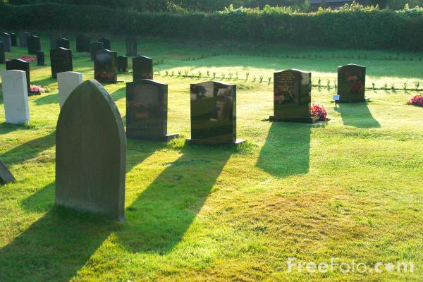
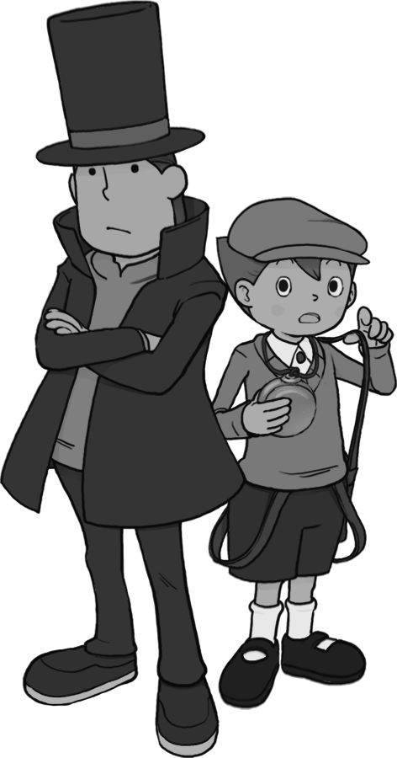
Sadly, shortly after their last experience with the DS; Layton and Luke died.
Click anywhere to advance text boxes...

Slide 4
But there is no need to worry...

Slide 5
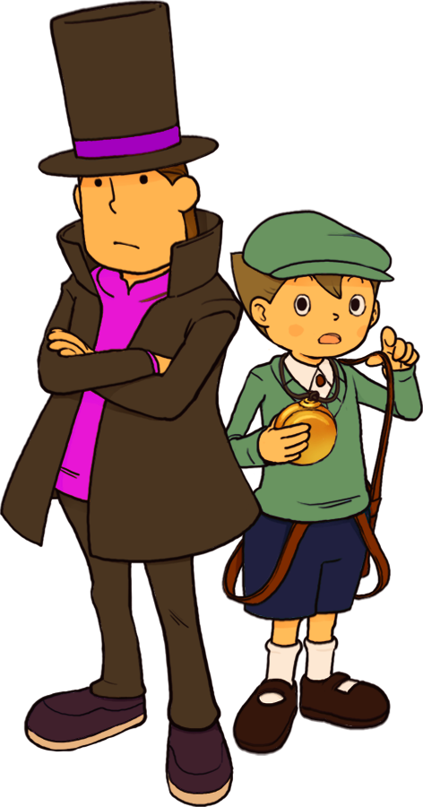
As, Professor PowerPoint and his acquaintance, Slide, are filling in for them!

Slide 6
Recently, PowerPoint and Slide received a letter.

Slide 7
Asking them about the ‘Impossible Puzzle’.

Slide 8
It seems this puzzle has not yet been solved by anyone.

Slide 9
Although the gentleman who founded the puzzle, shortly before he died, claimed the puzzle to be “a trick with an answer”.

Slide 10
Relatives and townspeople searched restlessly for the trick in the puzzle...

Slide 11
But to no avail.

Slide 12
The letter of which PowerPoint and Slide received, was from a ‘Lady Elizabeth’.

Slide 13
Elizabeth included a map to find her village.

Slide 14
Though, she didn’t make it quite clear...

Slide 15
She wanted to test PowerPoint and Slide to see if they really did have the potential to solve such a mystifying puzzle.

Slide 16
As PowerPoint walks on, Slide looks for an answer to Elizabeth’s map...

Slide 17
Puzzle 001
Lady Elizabeth has given PowerPoint and Slide a map. Only to leave them with these instructions;
“My house is where the sun doesn’t shine!”
What could this mean?
Hint – Click where you think she lives.
Solve!

Slide 18
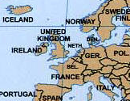

Puzzle 001
See explanation

Slide 19
Puzzle 001
Spot on!
In England they almost never get any fun weather.
Advance

Slide 20
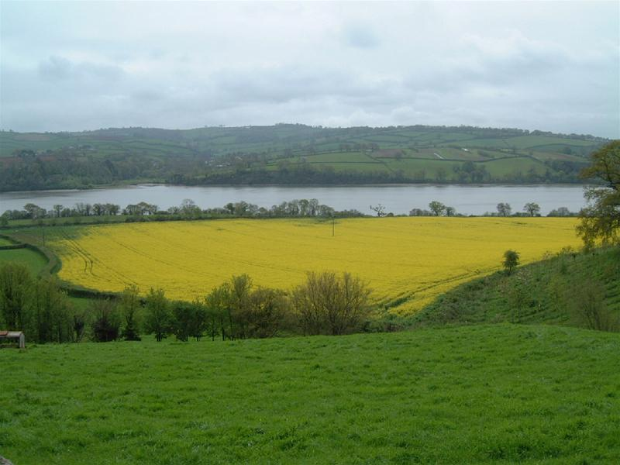
Another puzzle solved by the best apprentice of the famous Professor PowerPoint!

Slide 21
Great work, my boy!

Slide 22
Though, I have already arrived close to our destination...

Slide 23
So, you mean to say you already solved this puzzle?

Slide 24
Exactly.

Slide 25
A puzzle like that is do-able at a quick peek for anyone with my vast intellect.

Slide 26
But, I can’t lose the feeling we are not the only ones invited to this party.

Slide 27
Party? How? What do you mean, Professor?

Slide 28
Before I can tell you anything; I need to confirm our true surroundings...

Slide 29
How would one do that?

Slide 30
Ahh! I know! With a puzzle!

Slide 31
Exactly my thoughts, my boy.

Slide 32
I’m ready. Bring it on!

Slide 33
Puzzle 002
Professor PowerPoint is having trouble with his suspicions. Help Slide help PowerPoint!
“That tree there. It is brown. But the one next to it is green. Why is that?”
What do you think?
Hint – This puzzle is simple answers; ‘A’ and ‘B’ are the only answers. So if you get it wrong the first time; you’re sure to succeed the second!
Solve!

Slide 34
Puzzle 002
A – The two trees are softwood and hardwood trees, so they change colour in the winter.
B – The shape of the two trees are different causing them to lose their colour heat in summer.
See explanation

Slide 35
Puzzle 002
Correct!
Carnivorous (softwood) trees stay green all year round. Where as deciduous (hardwood) trees lose their colour in the winter.
Advance

Slide 36
I knew it!

Slide 37
My, you’re getting quite good at this!

Slide 38
Now come on, Slide. Lady Elizabeth’s house is right over this hill.

Slide 40
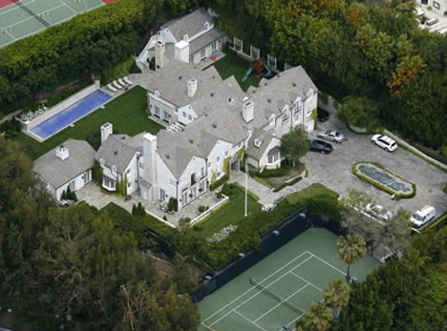
Here we are!

Slide 41
My, this place is HUGE!

Slide 42
We’re almost there.

Slide 43
Let’s just get a bit closer...

Slide 45
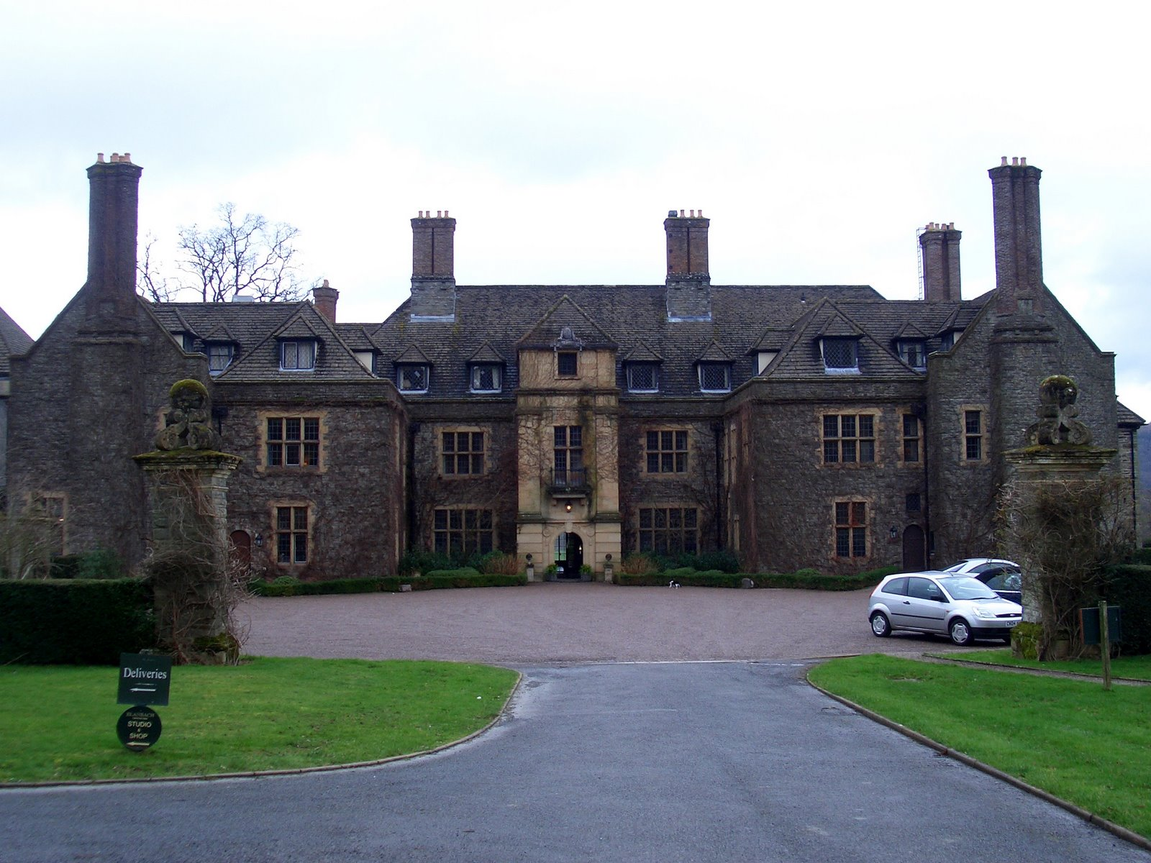
Right, now we’re here!

Slide 46
This house is even bigger up close!

Slide 47
I agree with you; this place is quite fascinating!

Slide 48
Now if only we could find a way to get in...

Slide 49
We were invited... Weren’t we?

Slide 50
So...

Slide 51
We COULD just knock...

Slide 52
Ahh... But a real professor’s acquaintance doesn’t just knock!

Slide 53
He solves a puzzle to gain entrance!

Slide 54
A ha! Another puzzle! Here I come!

Slide 55
That’s the spirit, my boy!

Slide 56
Puzzle 003
Professor PowerPoint is making Slide solve a puzzle to gain entrance to Lady Elizabeth’s house. Help Slide solve the puzzle to gain entrance!
Hint – This puzzle has nothing to do with the above text!
Solve!

Slide 57
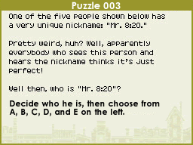
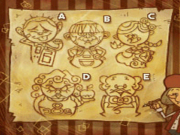
A
B
C
D
E
See explanation

Slide 58
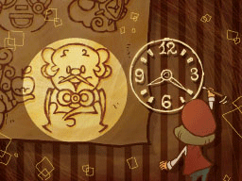
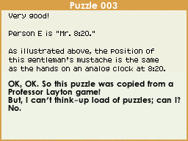
Advance

Slide 59
Puzzle 004
Wow! You found a hidden puzzle!
Hint – Click the advance button until it dissapears!
Solve!

Slide 60
Puzzle 004
Advance

Slide 61
Puzzle 004
Advance

Slide 62
Puzzle 004
Advance

Slide 63
Puzzle 004
Advance

Slide 64
Puzzle 004
Advance

Slide 65
Puzzle 004
Advance

Slide 66
Puzzle 004
Advance

Slide 67
Puzzle 004
Advance

Slide 68
Puzzle 004
Advance

Slide 69
Puzzle 004
Advance

Slide 70
Puzzle 004
Advance

Slide 71
Puzzle 004
Advance

Slide 72
Puzzle 004
Advance

Slide 73
Puzzle 004
Great! You can come back to this puzzle by clicking the green patch again!
Advance

Slide 74
Once, again... I’m a GENIUS!

Slide 75
And... DONE!

Slide 76
Let me guess...

Slide 77
You ALREADY solved the puzzle...

Slide 78
Yep!

Slide 79
One day I hope to grow up like you, Professor.
I want to be the best at puzzles like you!

Slide 80
Now, now, Slide. I wouldn’t say I’m exactly the BEST.

Slide 81
Anyway, come along now.

Slide 82
We must get going to the door!

Slide 83


Hey! Wait for me, Professor!

Slide 84
Come, Slide. We must hurry!

Slide 86

Slide! I’m over here!

Slide 88
Coming, Professor!

Slide 90
I’m here!

Slide 91
Good.

Slide 92
I’ll knock!

Slide 93
*knock* *knock*

Slide 94
Who is it?

Slide 95
It’s me! The professor!

Slide 96
Oh, great! Come in, come in!

Slide 97
Seems we’ve been invited in, Slide.

Slide 98
Well, let’s not dilly-dally! Come on!

Slide 99
Hold your pace, Slide!

Slide 100
C’mon!

Slide 101
OK! I’m coming!

Slide 103


Slide 104
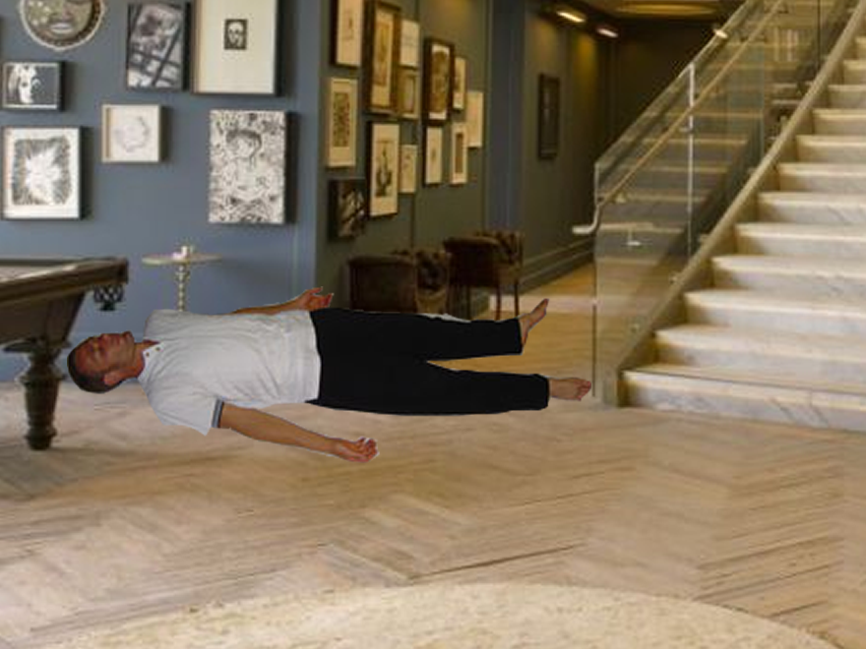

Slide 105
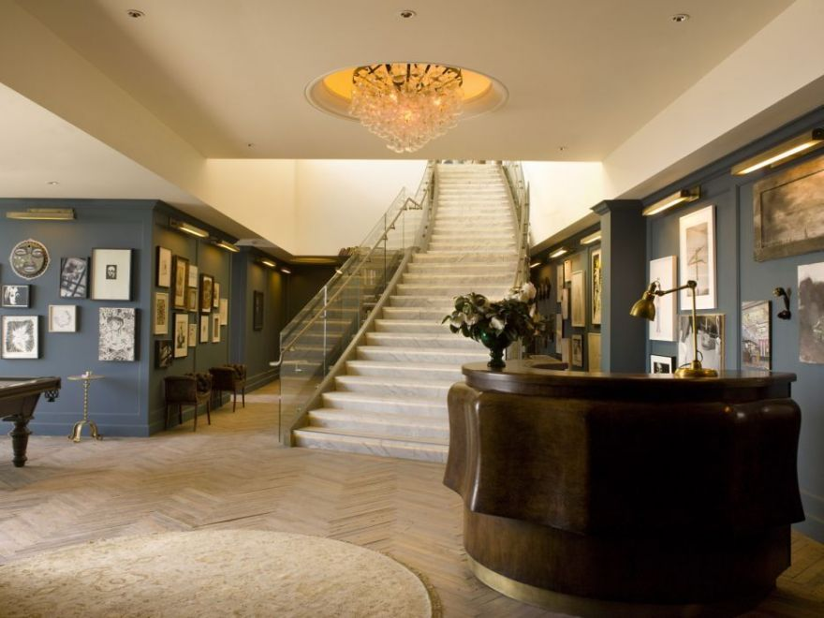

Oh, my...

Slide 106
What do you think happened here, Professor?

Slide 107
I... Can’t say...

Slide 108
How striking.

Slide 109
Where’s the person that let us in?

Slide 110

Here I--!

Slide 111
AAAAHHHHHHHHHHHHHHHHH!!!!!!!!------!!!!!!!

Slide 112
What have you done!?

Slide 113
No, miss! You’ve got it all wrong! I SWEAR we had nothing to do with this!

Slide 114
Charmed, I’m sure!

Slide 115
What?

Slide 116
That’s not the problem right now!

Slide 117
We need to find out who killed my hubby!

Slide 118
Your “hubby”? You mean your husband?

Slide 119
Yes!

Slide 120
He looks too awfully realistic to be your husband.

Slide 121
He didn’t come from the world of PowerPoint cartoon. He came...

Slide 122
From the real world. That’s why!

Slide 123
The WHAT!?

Slide 124
The real world!

Slide 125
Are you sure?

Slide 126
Yes I’m sure!

Slide 127
Now can we please find who killed my hub--

Slide 128
Husban--

Slide 129
SHUT UP!

Slide 130
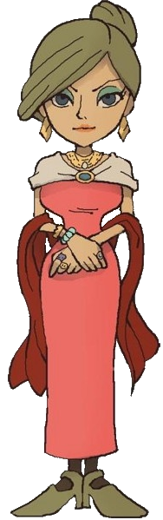
Sorry. I just get very angry when people kill my family members!

Slide 131
Professor, I’m scared...

Slide 132
Calm down, my boy!

Slide 133
I go to make tea for you and this is what I get!?

Slide 134
It wasn’t us!

Slide 135
Fine! I believe you!

Slide 136
But... If you didn’t then... Who DID!?...

Slide 137
Dun dun dun!

Slide 138
Slide. Me and Elizabeth need to talk.

Slide 139
Would you mind waiting outside for a minute?

Slide 140
OK.

Slide 141
Elizabeth.

Slide 142
Yes.

Slide 143
When was the last time you saw your husband alive?

Slide 144
You mean David? I last saw him last night, he was leaving to go to his workplace in the south of London, just below us.

Slide 145
Did you have any contact with David after that time?

Slide 146
It was 8:00pm. He called me at 10:00pm saying he was worried about his work. I thought nothing of it, and continued my day.

Slide 147
And, of course, I gave him some helpful advice.

Slide 148
So no contact was made AT ALL after 10:00pm?

Slide 149
That’s right.

Slide 151
Stupid Professor. Always leaving me while he talks to people in private.

Slide 152
I could help him! But, no! He has to leave me! All by myself!

Slide 153

Slide!

Slide 154

Uhh... Professor! Hi!

Slide 155
I won’t be a minute, Slide! Just hang on for a while out here!

Slide 156
OK! I will! Whatever you say!

Slide 157
Hey! What’s that car doing over there!?

Slide 158

Ahh!

Slide 159
Did we get him!?

Slide 160
I think so...

Slide 161
Heh. Heh heh heh. BWA HAHAHAHAHAHA!!!!

Slide 162
Is everything OK, your highness?

Slide 163
Yep. Everything is just... perfect...

Slide 166
Slide!

Slide 167
WHERE ARE YOU!?

Slide 168
I saw the whole thing from behind the window!

Slide 169
Oh, dear. Where is he?

Slide 170
I must leave, at once.

Slide 171
I’ll search the area first...

Slide 183
He’s... Gone...

Slide 184
ARGH!!!!

Slide 185
Why!? WHY, DID I HAVE TO LEAVE HIM OUTSIDE!? HE WAS ALL ALONE WITH NO-ONE THERE!

Slide 186
What’s happened Professor!?

Slide 187
I’m sad to say it but...

Slide 188
Slide was hit by a car.

Slide 189
Oh my. That... Is... Quite a problem.

Slide 190
OF COURSE IT’S A PROBLEM!

Slide 191
EXCUSE ME! I THINK YOU’RE FORGETTING
MY HUSBAND!

Slide 192

YOU!

Slide 193
ME?

Slide 194
No! That car, there! It’s the one that hit Slide!

Slide 195
Ha ha ha. How foolish of you talk to me that way.

Slide 196
I am not the one who killed Slide.

Slide 197
I am not the one who killed Slide..

Slide 198
I am not the one who killed Slide...

Slide 199
I am not the one who killed Slide... YOU ARE.

Slide 200
ME!? I DID NO SUCH THING!

Slide 201
Ahh... But you didn’t have to... You see...

Slide 202
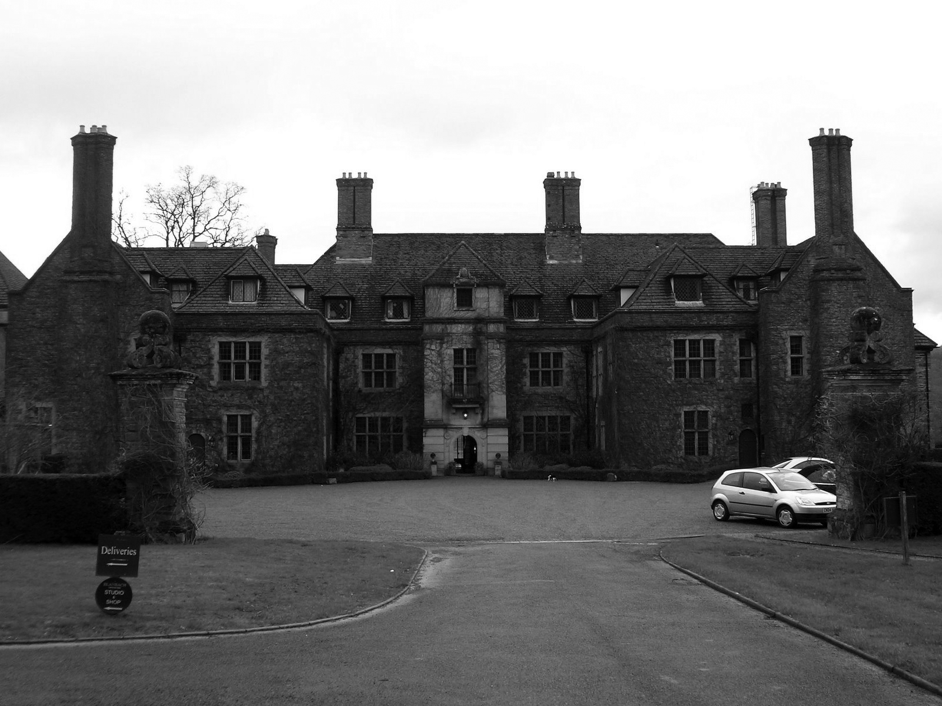

You weren’t there for Slide.

Slide 203
When he was hit by the car. Our car.

Slide 204
That moment, you looked out the window.

Slide 205
And at that moment, I know you realised your wrong-doings.

Slide 206
MY WRONG-DOINGS!?

Slide 207
YOU MEAN YOUR WRONG-DOINGS!

Slide 208
That may be so. But for now, you have no apprentice.

Slide 209
Come back here!

Slide 210
You know, *cough*, I could always be your apprentice...

Slide 211
No. It’s fine. It’s not the same without Slide.

Slide 212
But...

Slide 213
And you have your husband to attend to.

Slide 214
Very well then. You run off to find Slide and I’ll be waiting here, at home, for you to return with Slide to help find out the monster who killed my husband.

Slide 215
Sounds like a plan!

Slide 216
Great!

Slide 217
Be back as soon as possible!

Slide 218
I will do!

Slide 219
Bye!

Slide 220
Bye!

Slide 223
Puzzle 005
Slide was hit at 120mph. Which is fast enough to make anyone fly around one acre far back.
Click the area you think Slide landed on to solve the puzzle.
Hint – N/A
What!? You say!? Where is puzzle 4? Well you missed it! But there is one...
Solve!

Slide 224
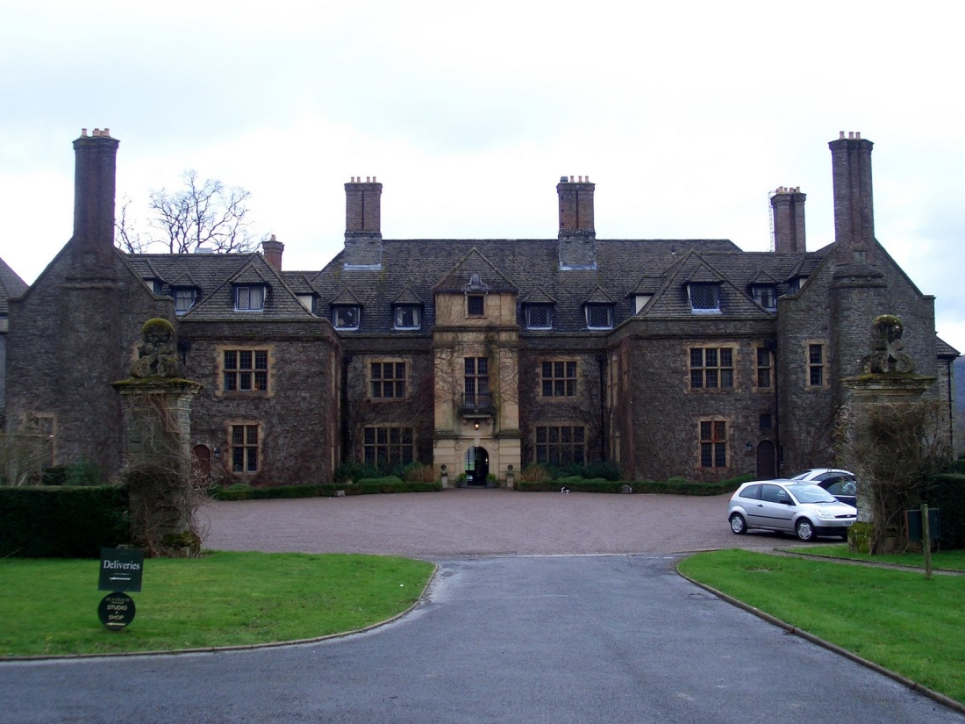
Puzzle 005
See explanation

Slide 225
Puzzle 005
Bang on!
Slide was flown all the way back here!
How unfortunate!
But it still makes me ROTFL!
No, no, no. I’m just kidding *cough*!
Advance

Slide 227
Thank you, gentleman. Now I know where to go!

Slide 228
Just a tiny bit further backwards...

Slide 229
PROFESSOR! HOLD UP!

Slide 231
Right now where could he have landed?

Slide 232


Slide 233
Slide!

Slide 234
I guess you...

Slide 235


Slide 236
Can slide in.

Slide 239
Kwl.

Slide 241
Professor?

Slide 242
Slide?

Slide 243
Slide?

Slide 244
Professor?

Slide 245

SPONGEBOB SQUAREPANTS!!

Slide 246
SPONGEBOB SQUAREPANTS!!

Slide 247
Umm, OK.

Slide 248
Well, that had nothing to do with the situation at this present time period!

Slide 249
Right. Back to the serious story...

Slide 250
Where did you just come from!?

Slide 251
I managed to hang onto the top of a street light and slide down it.

Slide 252
REALLY!?

Slide 253
Yeah! And I saw how sad you were about me. You really do care for me! Thanks, Professor!

Slide 254
I’m glad you think so.

Slide 255
By the time I held my bravery together to slide down the pole... You had already gone!

Slide 256
So I chased you here!

Slide 257
What a funny little story!

Slide 258
Now, come on.

Slide 259
I promised Lady Elizabeth we’d go and see her after I had found you.

Slide 260
Hold up!

Slide 261
I found this puzzle taped to the top of the street lamp...

Slide 262
Puzzle 006
Slide found a puzzle taped to the top of a street lamp. God only knows who put it there, but, oh well...
The street light on the far left is off so which one is on?
Hint – Think about the time of day.
Solve!

Slide 263
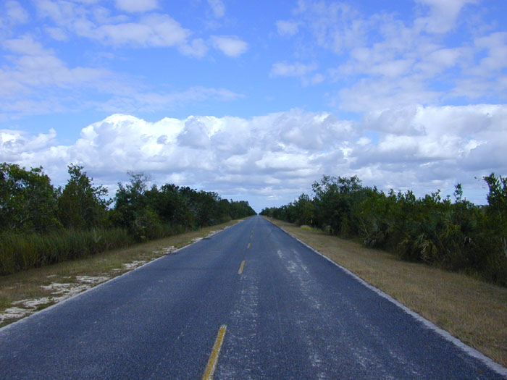





Puzzle 006
See explanation

Slide 264



Puzzle 006
Thaaaaat’s RIGHT!
If you know at daytime the lights are off;
You’ll know the other ones at daytime
are off, too!
And the one on the night road, the street
lamp on the far right, will be on!
Advance

Slide 265
How inquisitive! A puzzle about street lights!

Slide 266
Now come on, Slide. We must go back to Lady Elizabeth...

Slide 268
We’re back Elizabeth!

Slide 269
ELIZABETH!

Slide 270
I don’t think she can hear us, professor...

Slide 271
Indeed, Slide. Let’s walk further...

Slide 273
Oh, ooh! Let me knock, Professor!

Slide 274
Very well, then...

Slide 275
*knock* *knock*

Slide 276
Hmm, no answer...

Slide 277
Let me see...

Slide 278
*KNOCK!!* *KNOCK!!* *KNOCK!!* *KNOCK!!* *KNOCK!!* *KNOCK!!* *KNOCK!!* *KNOCK!!* *KNOCK!!* *KNOCK!!* *KNOCK!!* *KNOCK!!*

Slide 279
Hmph.

Slide 280
Nothing.

Slide 281
Do you think she could’ve died, too?

Slide 282
Two years later…

Slide 283
How DARE you be so pessimistique!

Slide 284
Are you practicing French?

Slide 285
Yes, my boy, I took it for GCSE because I had a space to fill.

Slide 286
It wasn’t a main choice.

Slide 287
Ha ha. Oui.

Slide 288
But what can we do about this?

Slide 289
It seems we’ll have to force our way in.

Slide 290
Wait a moment, sir!

Slide 291
1…

Slide 292
Wait!

Slide 293
2…

Slide 294
HOLD UP!

Slide 295
Huh?

Slide 296
I’m here!

Slide 297
Oh, thank goodness.

Slide 298
Slide, you wait out here while I talk to her in there again.

Slide 299
Okezzle.

Slide 300
What?

Slide 301
It’s my new ozzle language.

Slide 302
You are one strange child.

Slide 303
…

Slide 304
…

Slide 305
…

Slide 306
…

Slide 307
Kill yourself
…

Slide 308
So I found Slide…

Slide 309
Really?

Slide 310
Clearly.

Slide 311
Any new… info? On my hu------sband?

Slide 312
Not at the moment, madam.

Slide 313
WELL GET TO IT!

Slide 314
I’m working as fast as I can.

Slide 315
Sorry. I just… really miss him.

Slide 316
Why is his body still there?

Slide 317
I- I can’t afford to call the funeral service.

Slide 318
You live in a mansion.

Slide 319
Did I say that I owned it?

Slide 320
Tyrone bought me this then I kicked his ass out.

Slide 321
Mmhmm. You go on your way, female human!

Slide 322
Anyway if you can’t stand the smell; let me clean this up.

Slide 323
M-

Slide 324
Mm…

Slide 325
BLEAURGH!

Slide 326
I think I really do need to clean this up.

Slide 327
I’ll help you.

Slide 328
One

Slide 329
Two

Slide 330
Three

Slide 331
AAGH!

Slide 332
Did he just… talk?

Slide 333
End of Chapter 1
I hope you enjoyed the first chapter of this obviously terrible Professor Layton fan made game.
Exit

